Slide 1
Musaka
Robotic site

Slide 2
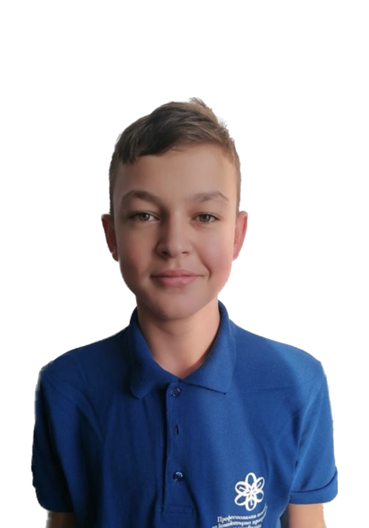
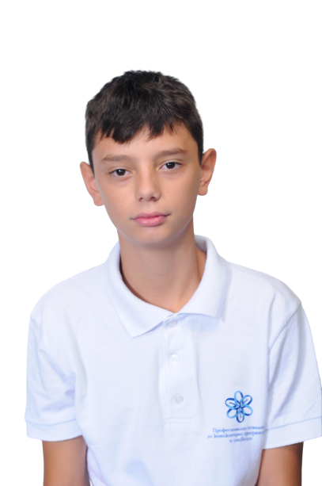
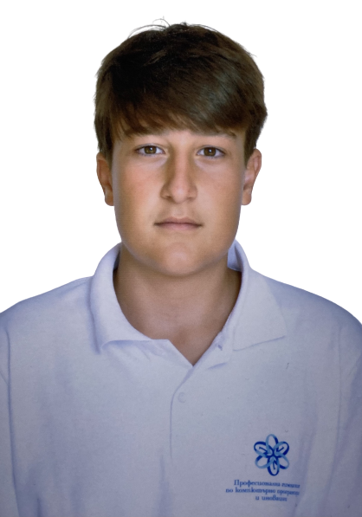
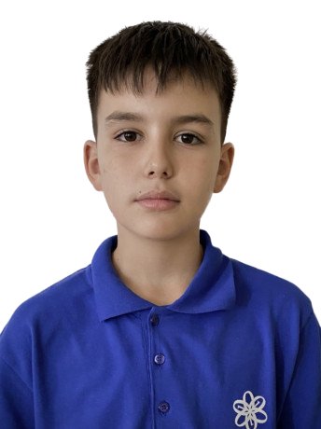
Our team
Scrum trainer
Asparuh Georgiev
Designer
Stefan Ivanov
Front-end developer
Georgi Stoyanov
Front-end developer
Maxim Mateev

Slide 3
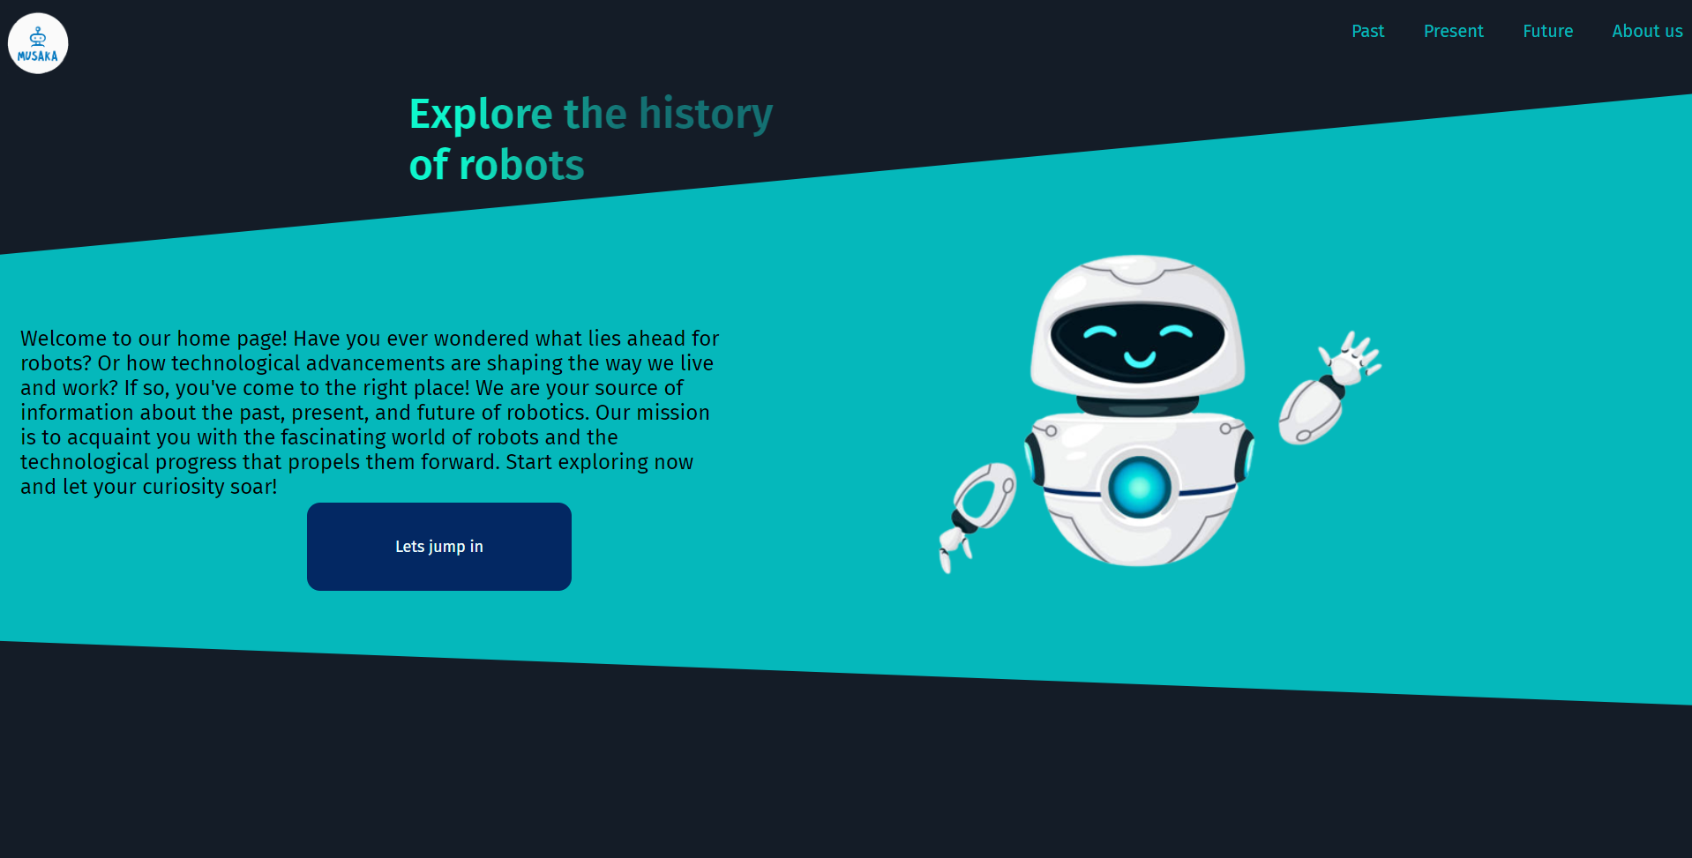
Our Idea
Our idea was to create a site about the past the present and the future of robotics.

Slide 4








Tech used

Slide 5
Lets move on with our site.

